Slide 1
CST 1101-D592 63795
Computer Programming and Problem Solving
Final Exam
Spring 2018
Professor HG Locklear

Slide 2
UML
Message
Sender (String) Recipient (String) Text (String)
displayMessage(self)…displays the Sender, Recipient, and Text of the message…see Expected Output slide for format
Create the following Message objects
Sender | Recipient | Text
Professor Locklear | Python Class | ‘Good Luck on your exam today’
Professor Locklear | Python Class | ‘Great Job this semester’
Professor Locklear | Python Class | ‘Have a great summer’

Slide 3
UML
EmailServer
Name (String) IPAddress (String) messageBuffer (List)
displayMessageCount(self)…prints the number of messages on the EmailServer in the following format… ‘There are [message count] messages on the Email Server’ displayEmailServerStatus(self)…prints the status of the Email Server in the following format… Server Name: Server IP: Server Message Count: Server Status: (GOOD) if server contains messages and (BAD) if server contains no messages displayMessages(self)…calls the displayMessage method for each message on the EmailServer
Create the following EmailServer object
Name | IPAddress | Message Buffer
CST1101Server | 127.000.001 | **All Messages created on slide 2

Slide 4
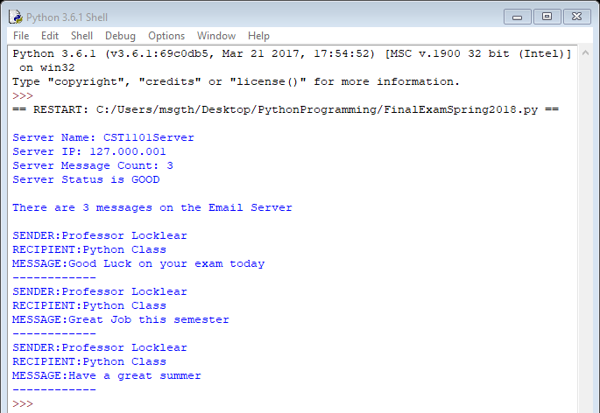
Programming Tasks
Create the Message Class.
Create Message objects
Create the EmailServer Class
Create EmailServer object
Call the displayEmailServerStatus method on the EmailServer object
Call the displayMessageCount method on the EmailServer object
Call the displayMessages method on the EmailServer object
Expected Script Output
TASK #5
TASK #6
TASK #7

